Slide 1
2024
WIREFRAME DOCUMENTATION
BUDGET SALES ANALYSIS
AMAN PRATAP SINGH

Slide 2
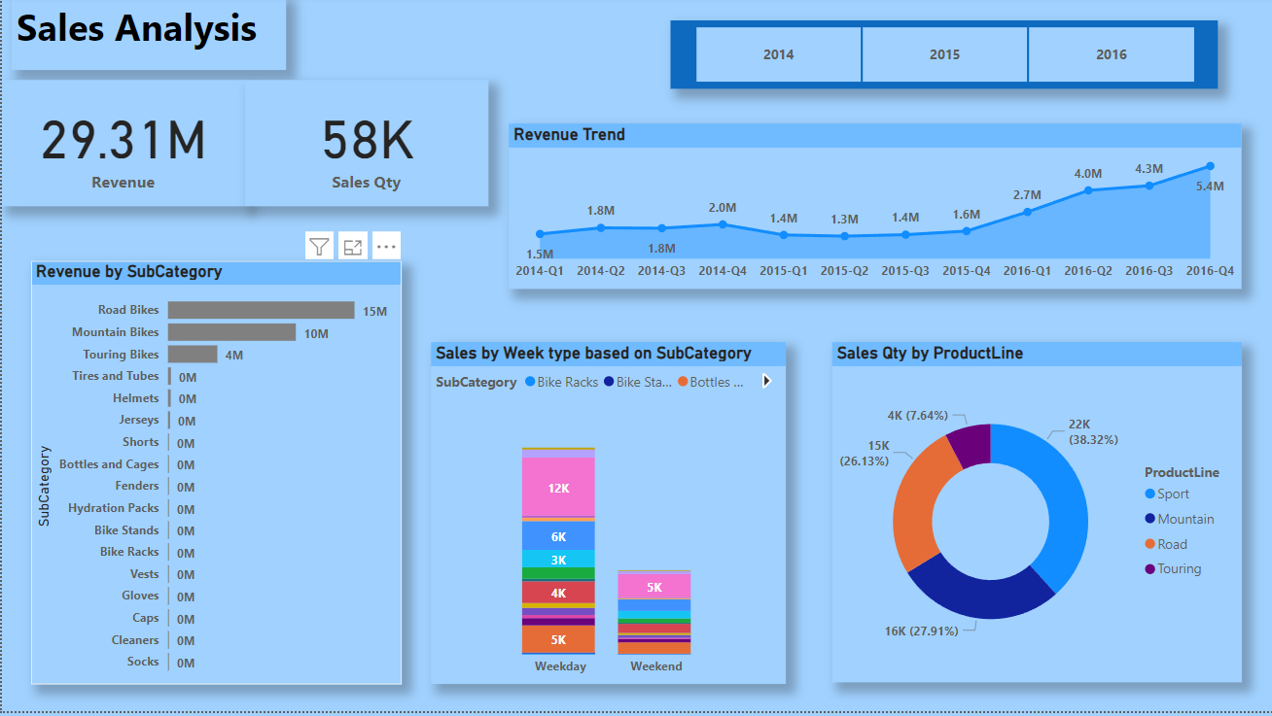
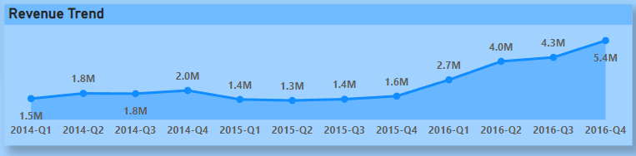

1 WIREFRAME DOCUMENTATION
As per the problem statement, we have divided analysis into four sections: -
1. Sales Analysis:
In this section we designed our first dashboard and tried to interpret the followings: -
Sales trend over the year

Slide 3
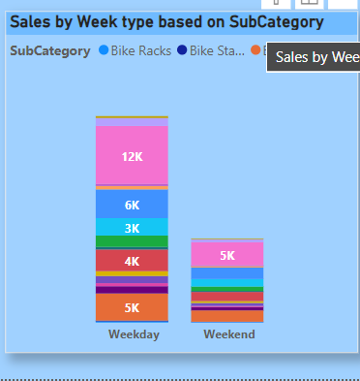
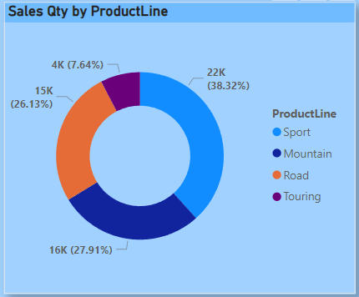
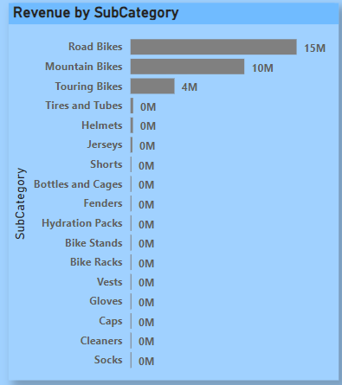
2 WIREFRAME DOCUMENTATION
 | Sales by week types based on their subcateory .
Sales of the goods in different productline.
 | Turnover Generated by Product Subcategory

Slide 4
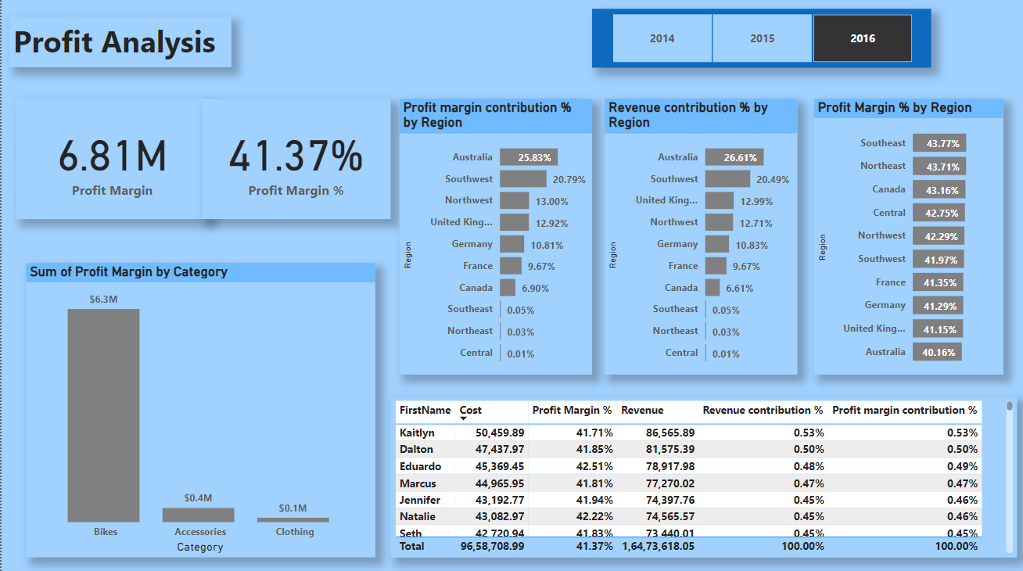
2. Profit Analysis:
3 WIREFRAME DOCUMENTATION

Slide 5
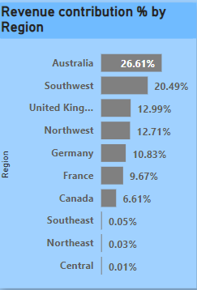
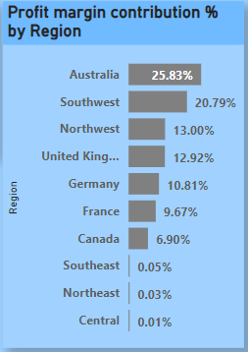
4 WIREFRAME DOCUMENTATION
 | Stacked bar chart of revenue contributed by region in percentage
Stacked bar chart of profit contribution by region in percentage

Slide 6
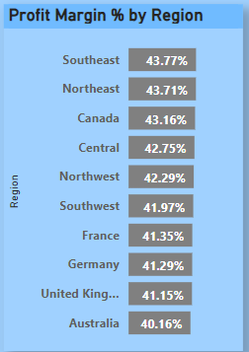
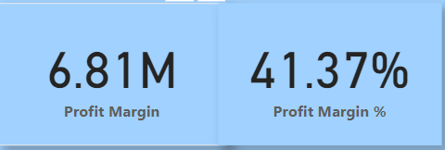
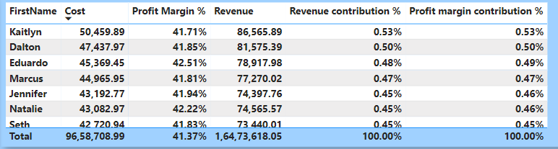
5 WIREFRAME DOCUMENTATION
 | Stacked bar chart of profit by region in percentage
Key performing indicators
Revenue details by customer

Slide 7
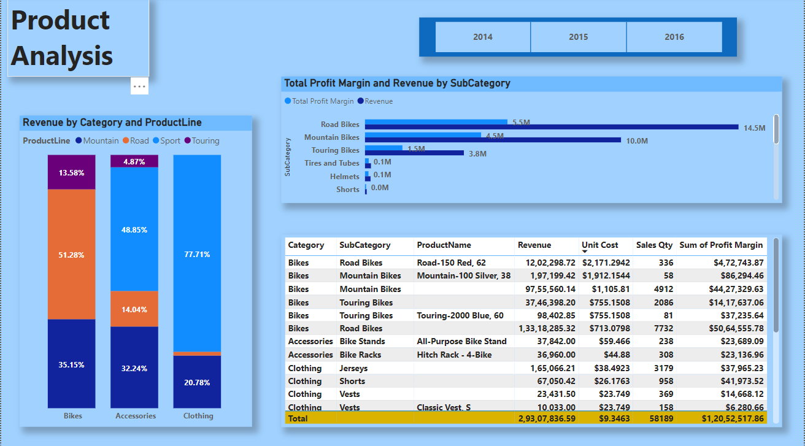
6 WIREFRAME DOCUMENTATION
3. Product Analysis

Slide 8
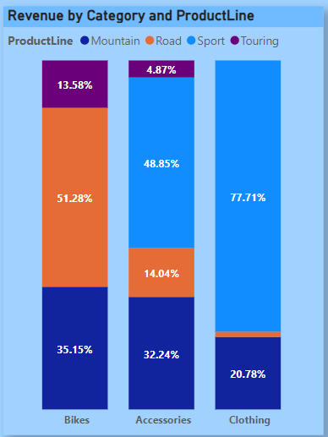
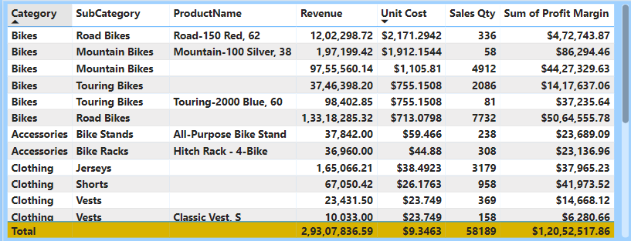
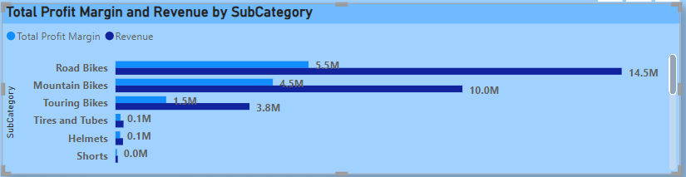
7 WIREFRAME DOCUMENTATION
Comparing actual sales by category and productline
Matrix Table for comparing sales with target category wise
Profit Margin and Revenue by subcategory

Slide 9
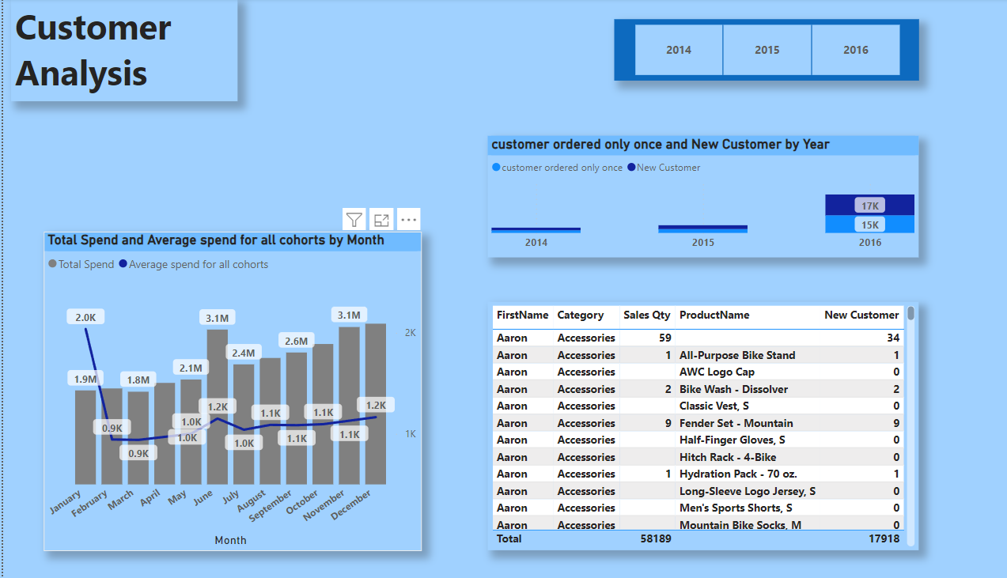
8 WIREFRAME DOCUMENTATION
 | 4. Customer Analysis

